Slide 1


Manhattan Sales Price Prediction
Sponsored by APT212 INC.
Group 3
Yaxin Xu, Jessica Jiang, Eric Sedaghat, Zhirui Chen

Slide 2

INDEX
Project Summary
About APT212
Business Problem
Analytic Problem Statement
Problem Solving Approach
Results & Analysis
Risks & Improvements
Conclusion

Slide 3

Project Summary
New York Real Estate Market
Significance of accurate pricing
APT212 Investment projection model
What's missing?
Where we come in
Similar Projects
Approach to the problem
Time Constraint
Notes:
Eric

Slide 4

2. About APT212
Growing and Disruptive Force
Sales
Developments
Financing
Rentals
How they are moving into investment space
Key is bridging the gap of knowledge for the uncommon investor
Where our model comes in
Notes:
Eric

Slide 5
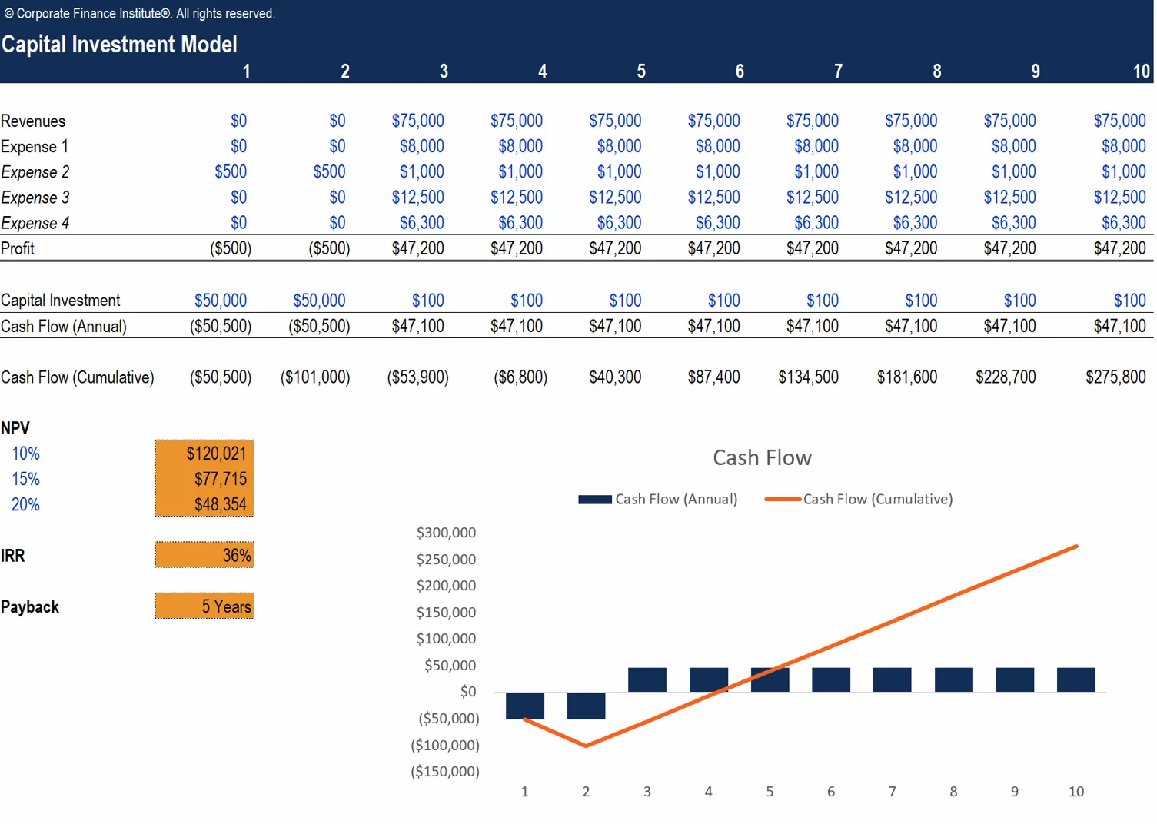
3. Business Problem
Extend Real Estate investment opportunity to everyday people
Empower those who don’t have the background nor the time to learn about real estate
Investment Model
Allows potential investors to looks different opportunities in common metrics like ROI, IRR, and net gain
Requires user input of Sales and Rental Prices
Build a model to help users fill out the investment model with confidence
Notes:
Eric

Slide 6

4. Analytic Problem Statement
Data Source
NYC Open Data provided by Department of Finance
Structure of Data
Minimize dataset dimension
Get data ready for modeling
Models
XGBoost
Random Forest
Lasso Regression
Support Vector Regression
Neural Network
Mean Square Error
How to evaluate a model’s performance

Slide 7
5. Problem Solving Approach
Data Cleaning
Feature Engineering
Missing purchase details
Large amount of missing values
Square feet columns include too many “0” values
Filtering (Single unit in Manhattan)
Change data type
Feature Selection
Dataset Limitations
Drop variables
Numeric and categorical
New variables (Year, Month, Day)
Adjust Outliers
Notes:
Data Cleaning
Drop variables (numeric and categorical)
Feature Selection
Filtering (Single unit in Manhattan)
Change data type
Feature Engineering
New variables (Year, Month, Day)
Adjust Outliers
Dataset Limitations
Missing purchase details
Large amount of missing values
Square feet columns include too many “0” values

Slide 8
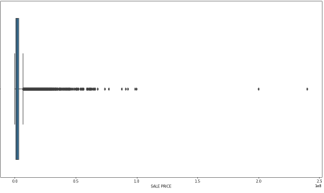
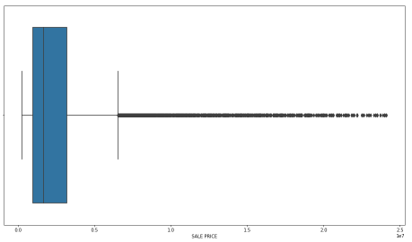
6. Results & Analysis
Box Plot Against Sale Price
Before
After

Slide 9
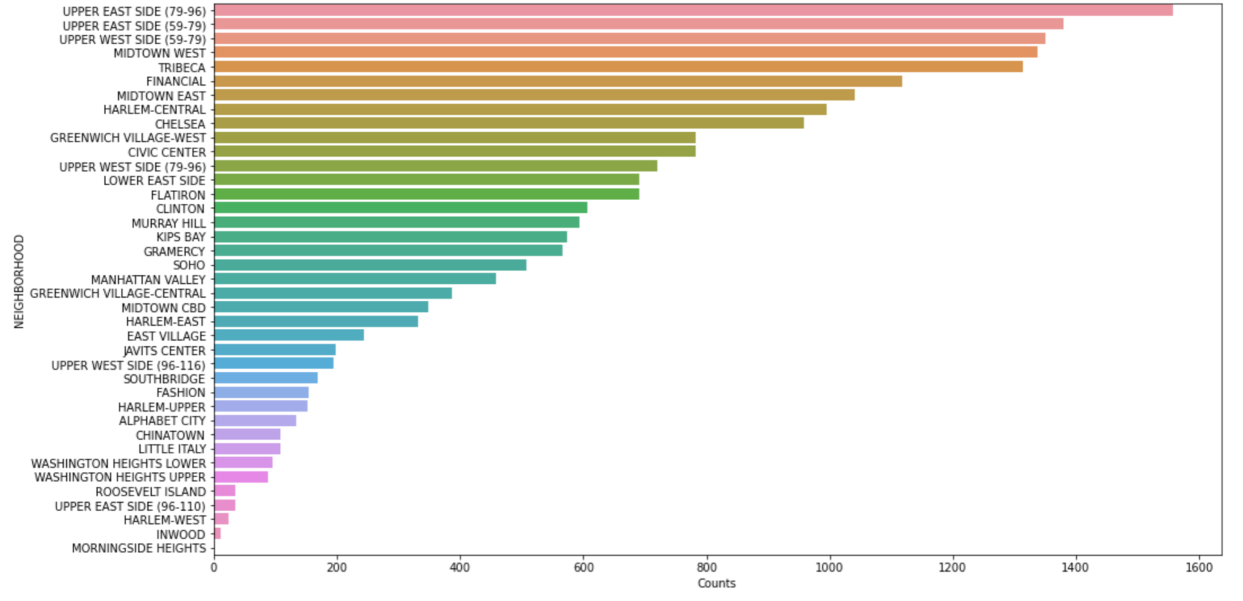
Number of Listings Per Neighborhood

Slide 10
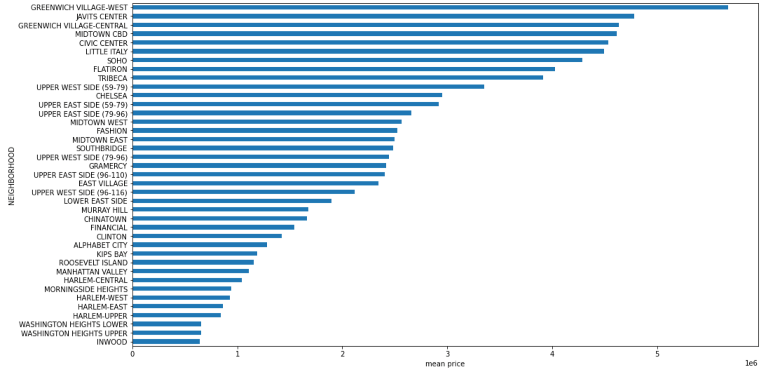
Mean Price of Each Neighborhood

Slide 11
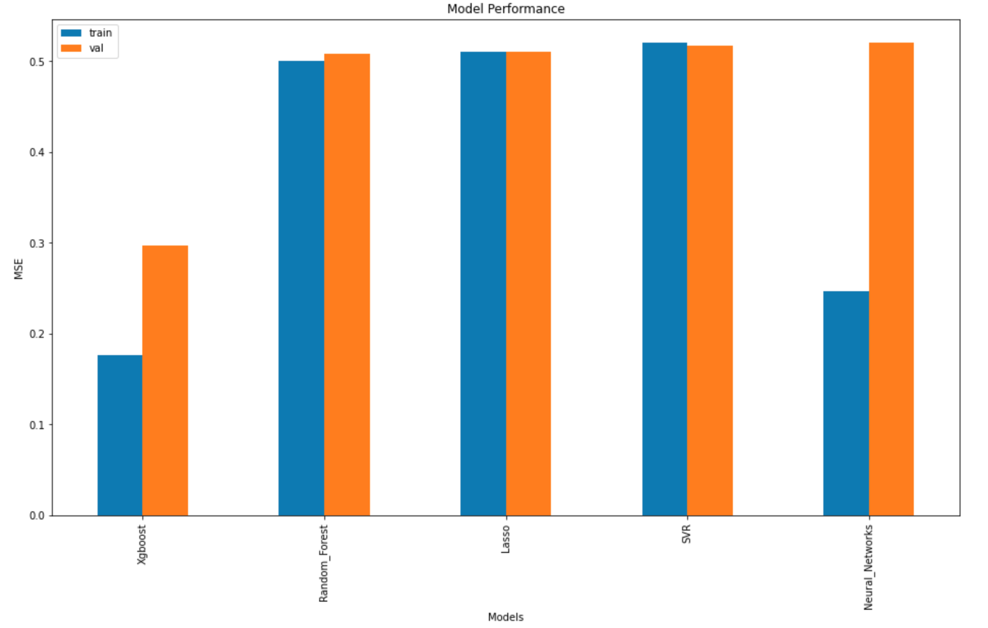
6. Results & Analysis
Based on Mean Squared Error (MSE)
 | Training | Validation
XGBoost | 0.176455 | 0.296757
Random Forest | 0.500639 | 0.508324
Lasso | 0.509807 | 0.510199
SVR | 0.520197 | 0.516380
Neural Networks | 0.246855 | 0.519644

Slide 12
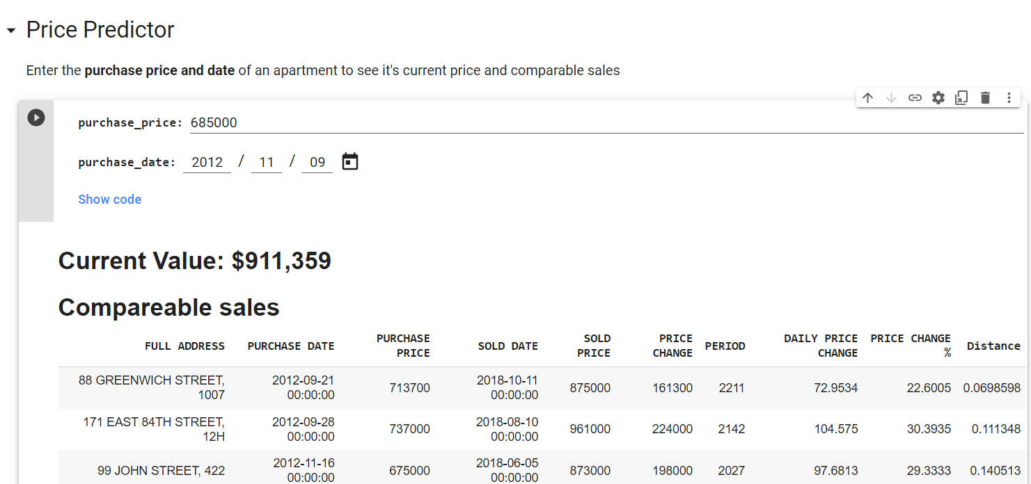
7. Risks & Improvements
Risks
Market
Competitive/Reputation
Quality
Resources
Financial
Improvements
Community features variables
Keeping more categorical variables
Price Prediction Calculator

Slide 13

8. Conclusion
XGBoost performed the best
Neighborhood is a big factor in determining sales price
Model has to adjust to trends and cycles, continuous improvement
Real estate market is bouncing back from the pandemic - high demand for luxury real estate
APT212 will continue to be a disruptive force in NYC real estate providing the best for their clientele and those new to real estate.

Slide 14

Thank you!

Slide 15
Citations
Asaftei, Gabriel Morgan, et al. “Getting Ahead of the Market: How Big Data Is Transforming Real Estate.” McKinsey & Company, McKinsey & Company, 30 Mar. 2021, www.mckinsey.com/industries/real-estate/our-insights/getting-ahead-of-the-market-how-big-data-is-transforming-real-estate.
Barr, Daniel. “Real Estate Valuation Using Regression Analysis – a Tutorial.” Toptal Finance Blog, Toptal, 28 June 2018, www.toptal.com/finance/real-estate/real-estate-valuation.
Jermain, Nate. “Home Value Prediction.” Medium, Towards Data Science, 5 Apr. 2019, towardsdatascience.com/home-value-prediction-2de1c293853c.
Nguyen, Joseph. “4 Key Factors That Drive the Real Estate Market.” Investopedia, Investopedia, 28 July 2021, www.investopedia.com/articles/mortages-real-estate/11/factors-affecting-real-estate-market.asp.
Paynter, Sarah. “Here's Where NYC's Real Estate Market Stands Right Now.” New York Post, New York Post, 20 July 2021, nypost.com/article/nyc-real-estate-market-housing-prices/.
Shkury, Shimon. “Q2 2021 Numbers Affirm New York City's MULTIFAMILY COMEBACK.” Forbes, Forbes Magazine, 6 Aug. 2021, www.forbes.com/sites/shimonshkury/2021/08/06/q2-2021-numbers-affirm-new-york-citys-multifamily-comeback/?sh=4ff333d52144.

